Slide 1
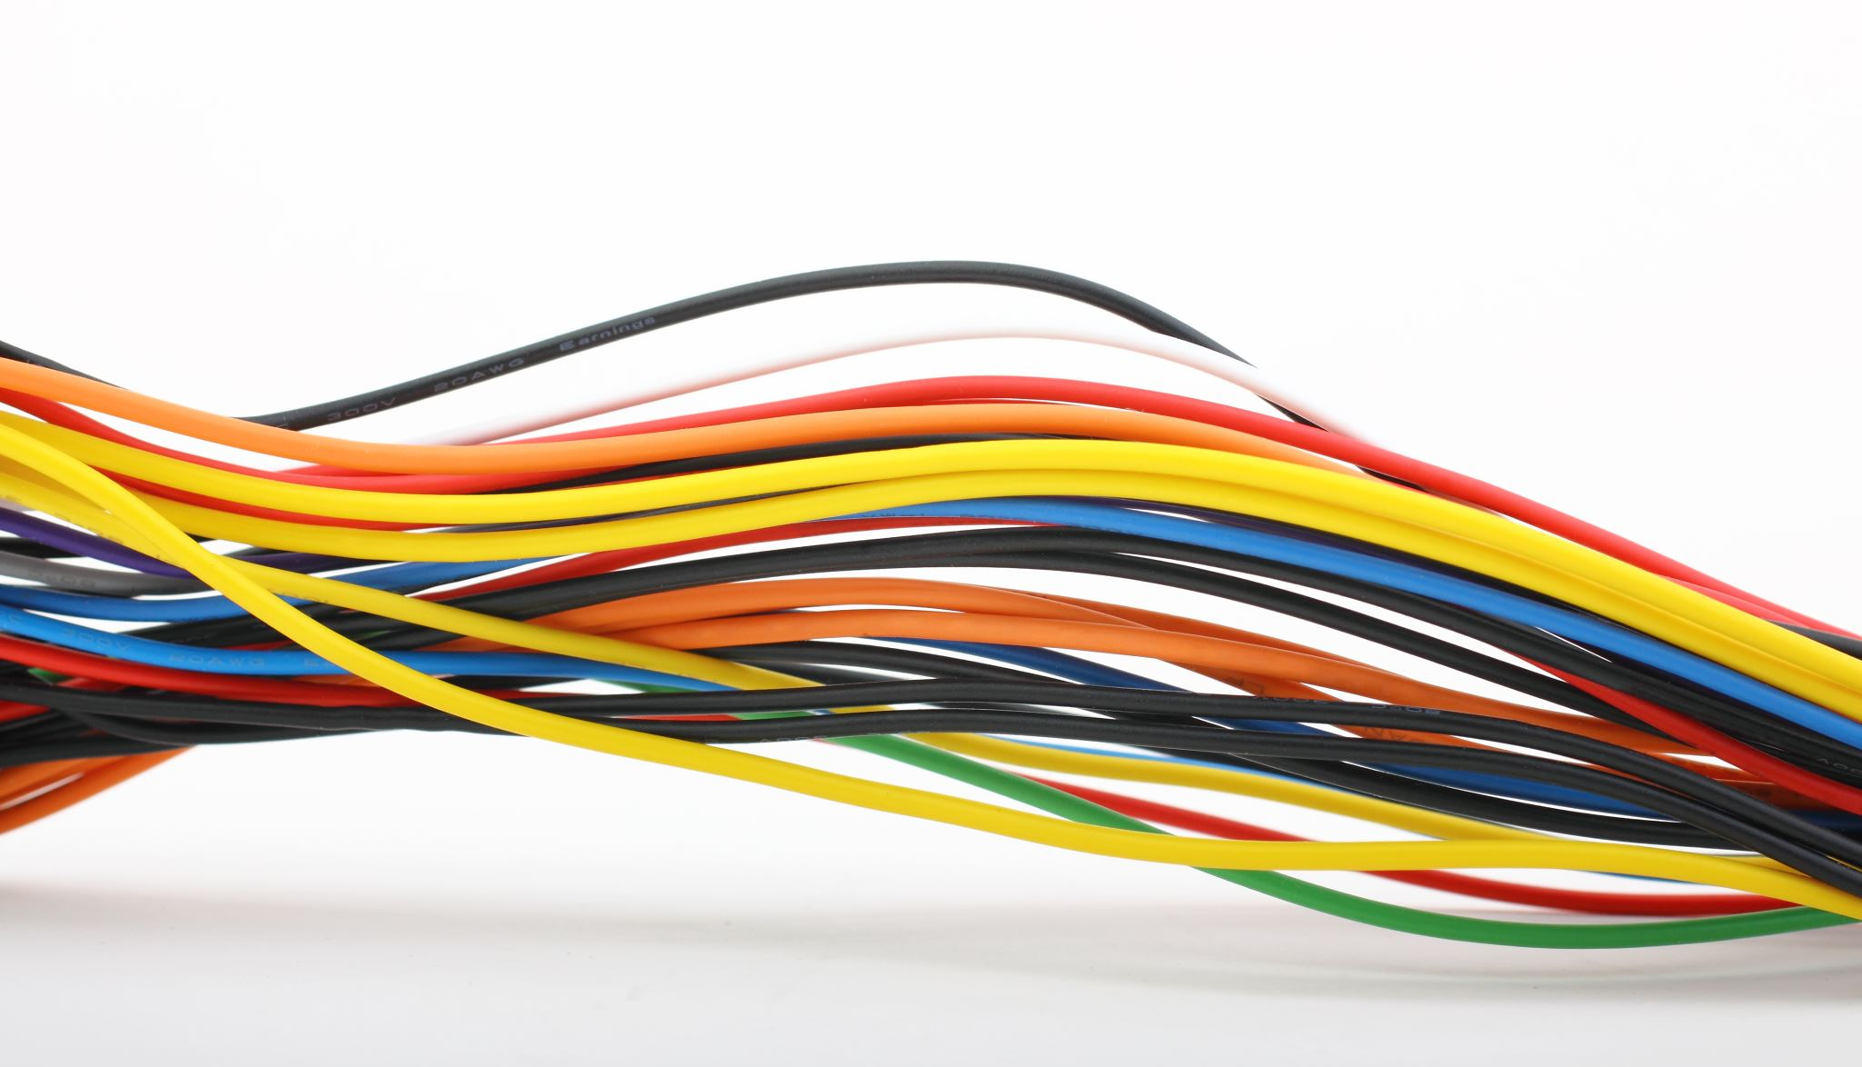
Resistance

Slide 2
Lecture Outline:
Series and parallel Resistance
Current And voltage division
Equivalent resistance

Slide 3
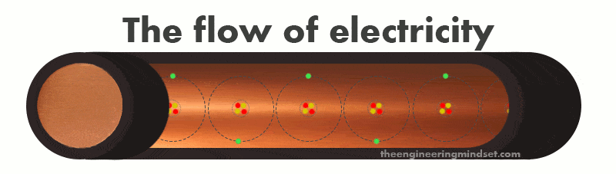
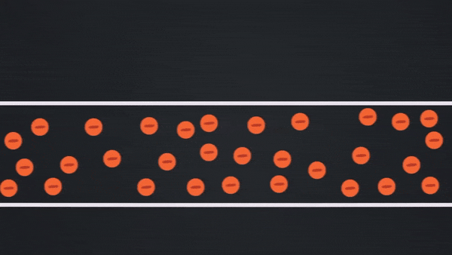
Resistance

Slide 4
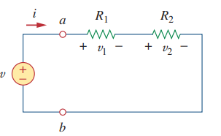
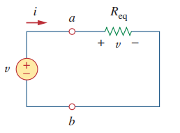
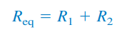
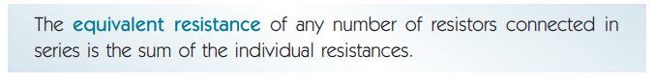
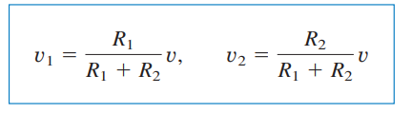
Series Resistors and Voltage Division

Slide 5
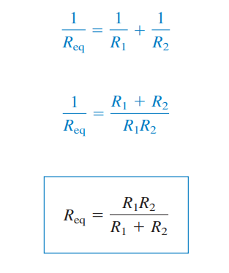
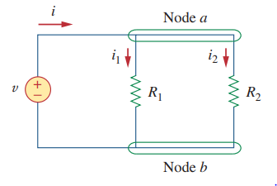
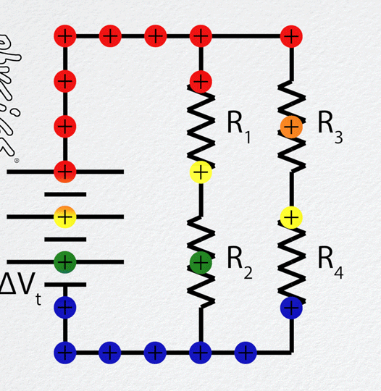
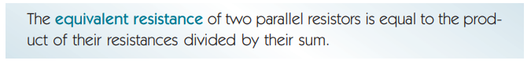
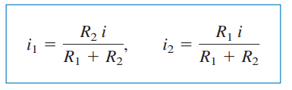
Parallel Resistors and Current Division

Slide 6
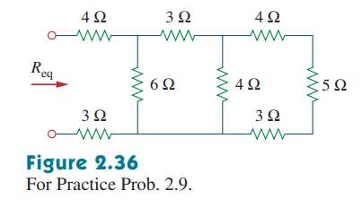
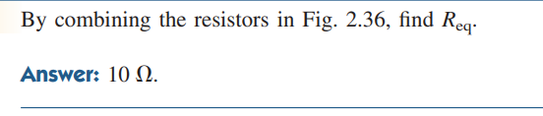
Math Problem Practice:
${Ans: R}_{\text{eq}}$ = 10 Ω
Reference: Sadiku_Practice_Problem_2.9

Slide 7
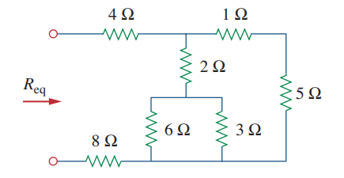
Math Problem Practice:
Find $R_{\text{eq}}$ for the circuit shown in Fig.
${Ans: R}_{\text{eq}}$ = 14.4 Ω
Reference: Sadiku_Example_2.9

Slide 8
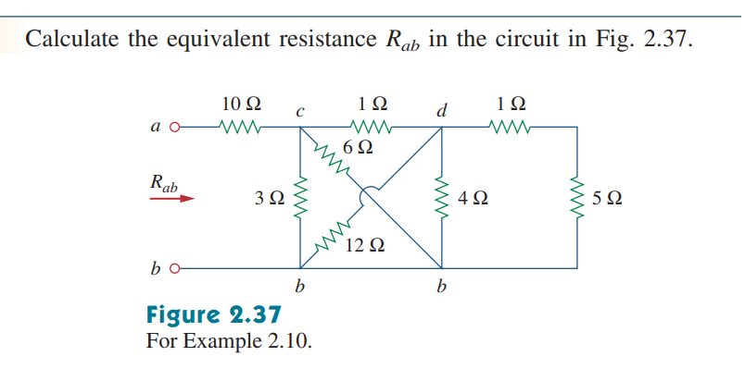
Math Problem Practice:
Find $R_{\text{eq}}$ for the circuit shown in Fig.
${Ans: R}_{\text{eq}}$ = 11.2 Ω
Reference: Sadiku_Example_2.10

Slide 9
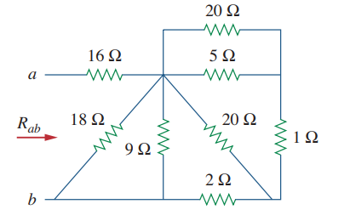
Math Problem Practice:
Find $R_{\text{eq}}$ for the circuit shown in Fig.
${Ans: R}_{\text{eq}}$ = 19 Ω
Reference: Sadiku_Practice_Problem_2.10

Slide 10
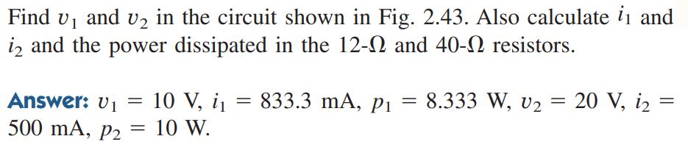
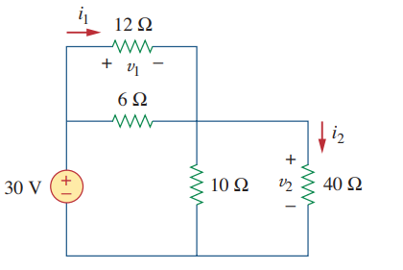
Math Problem Practice:
Reference: Sadiku_Practice_Problem_2.12

Slide 11
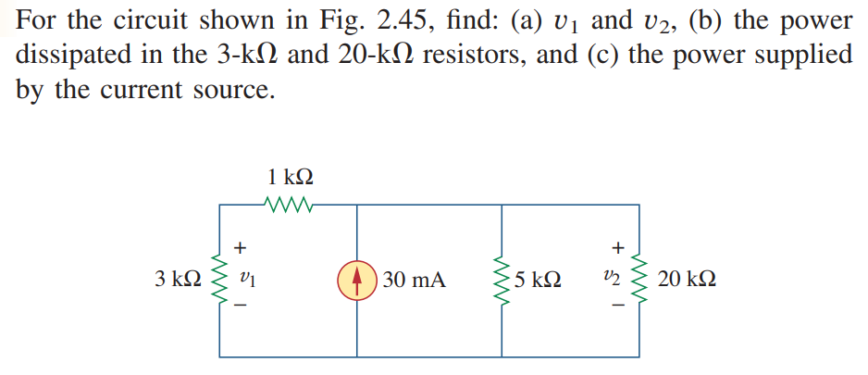
Math Problem Practice:
Reference: Sadiku_Practice_Problem_2.13

Slide 12
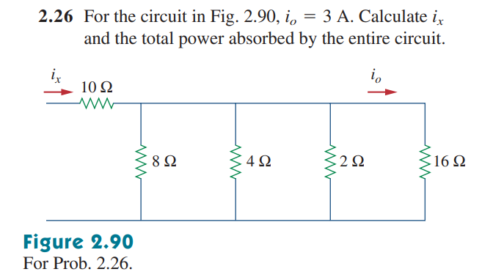
Math Problem Practice:
Reference: Sadiku_Exercise_Problem_2.26

Slide 13
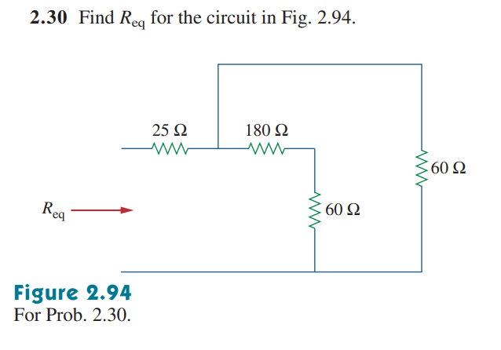
Math Problem Practice:
Reference: Sadiku_Exercise_Problem_2.30

Slide 14
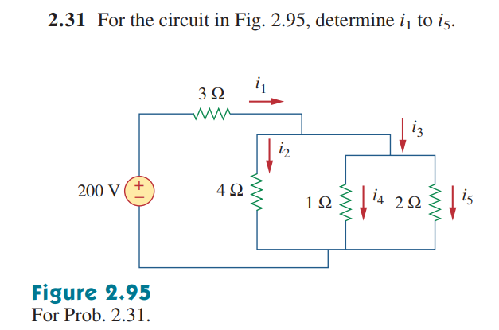
Math Problem Practice:
Reference: Sadiku_Exercise_Problem_2.31

Slide 15
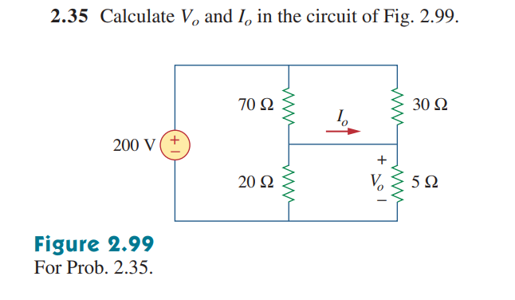
Math Problem Practice:
Reference: Sadiku_Exercise_Problem_2.35

Slide 16
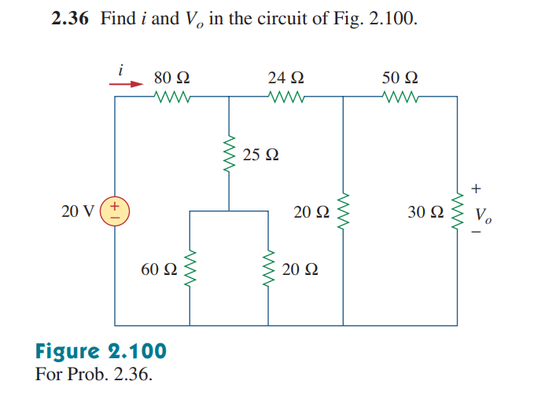
Math Problem Practice:
Reference: Sadiku_Exercise_Problem_2.36

Slide 17
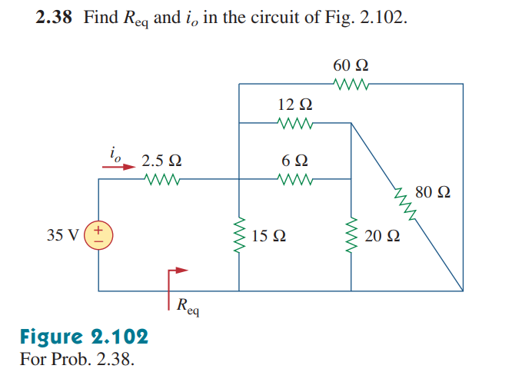
Math Problem Practice:
Reference: Sadiku_Exercise_Problem_2.38

